Slide 1
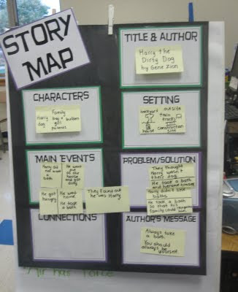
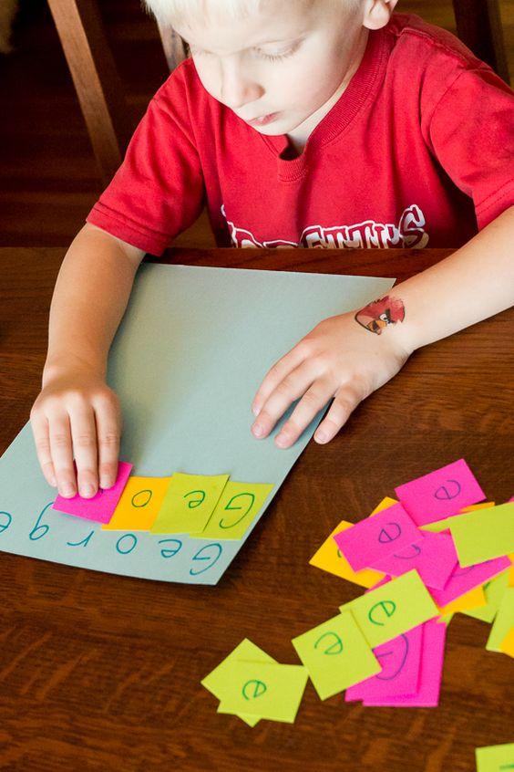
-Sticky Note Strategy-
Dana Luck #20
What is it?
Who will it work for?
What does it help students overcome?
A reading strategy that helps students keep track of an idea, theme, or details while reading in a textbook. It also teaches students the skills proficient readers use:
• Making connections to their lives or other texts,
• Talking back to texts and authors — commenting, questioning, predicting.
This strategy will work for anyone that wants to help assist their skills or wants to even try something new. This is also really helpful to students with ADHD.
Selective attention problems
Sustained Attention Problems
Impulsivity
High Levels of Verbal and Motor Activity
Steps:
1) Prior to turning students loose on a text, determine the purpose for the reading.
2) Explain the purpose for the reading to the students.
3) Distribute sticky notes.
4) As the teacher reads to the students, the student will pull off a sticky note, make a comment related to the reading on it and attach it to the page in their own book.
5) In follow-up discussions sticky notes can guide students in their comments shared, or questions raised, or predictions given.

Slide 2
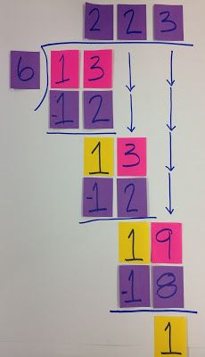
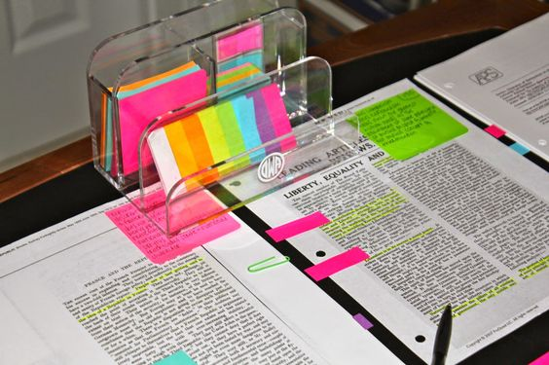
Ways To Incorporate in Teaching:
4. Impulsivity:
Create a list of projects students can work on when they are stuck or have completed a task in class. Teachers can place the list on a sticky note.
Help children monitor their behavior. Teachers can give children a certain number of sticky notes for an hour, morning, or day, and each time students talk out of turn or provide off-topic comments, they have to give the teacher a note.
3. Sustained Attention Problems:
Have students create an order for their completion of tasks on a sticky note on their desks.
Students can use sticky notes at their desks to remind them what they need to do during a specific time period.
Take-home and bring-to-school sticky notes could be made using different colors.
Use sticky notes to have students summarize and interact with reading materials. Many strategies for determining main ideas, supporting details, or determining setting elements can include sticky notes. Or even just ask questions.
1. Selective Attention Problems:
Children can also use a sticky note to mark where they stop within an assignment when they take a break.
For attention to independent seatwork, have students highlight what to attend to first next to the priority assignment), “2nd and “3rd” (third).
When practicing spelling words, have students cover spelling words with a sticky note, write the word next to the note, then compare their spelling with the correct spelling.
Use sticky notes to provide prompts if error analysis reveals a predictable pattern of errors in student work, such as forgetting to complete one step or difficulty with one type of problem.
Use sticky notes to help students practice executing specific steps or processes. If students have a hard time remembering how to complete one type of problem then they can put a permanent model of a completed problem on a sticky note.
2. High Levels of Verbal and Motor Activity:
Have children come up with thoughts and questions during class. Children should write or draw these questions on sticky notes and then have time at the end of class to discuss their questions and comments.
Teach children appropriate ways to engage in specific activities that would allow for their activity needs to be met in the classroom. Place sticky notes on their desks of children. Ex: moving to another desk, going to a standing desk, or asking to take a bathroom break.
Have a certain number of free movement passes for children to use when they need to move around more than just within the classroom with sticky notes.
Resources:
Stormont, M. A. (2008). Increase Academic Success for Children with ADHD Using Sticky Notes and Highlighters. Intervention In School And Clinic, 43(5), 305-308.
Wells, J. j., & Sheehey, P. H. (2012). Person-Centered Planning. Teaching Exceptional Children, 44(3), 32-39.
Xie, B., Druin, A., Fails, J., Massey, S., Golub, E., Franckel, S., & Schneider, K. (2012). Connecting generations: developing co-design methods for older adults and children. Behaviour & Information Technology, 31(4), 413-423 11p.
Morozov, M., Smorkalov, A., & Fominykh, M. (2014). Sticky Notes -- A Tool for Supporting Collaborative Activities in a 3D Virtual World. 2014 IEEE 14Th International Conference On Advanced Learning Technologies, 683.

